Slide 1
GEOGRAPHICAL INFORMATION SYSTEM (GIS)
SCS3204
LECTURER 4
GIS FUNDAMENTALS
BY
Dr. Fredrick Kanobe (Ph.D)
Tel contact: 0782-592120 Emails: fkanobe@kyu.ac.ug or fred.Kanobe@gmail.com

Slide 2
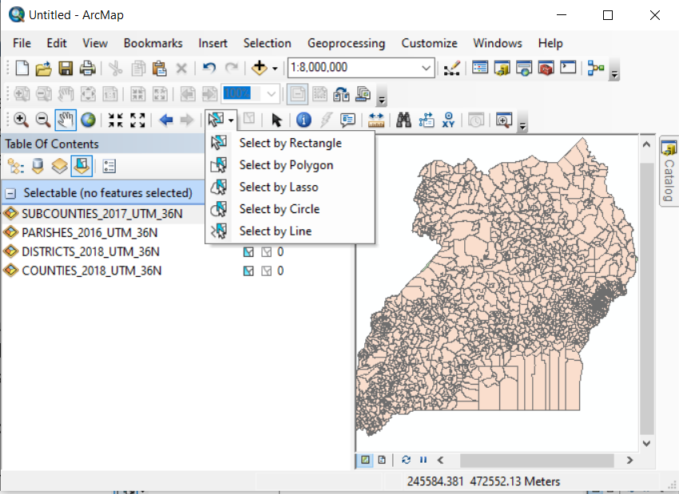


Setting Selectable Map Layers
When working with many layers in the ToC, you can determine which layers you want to select features from by disabling some layers that might not be put to use. Once you set layers selectable ArcMap will only enable you to highlight layers from the selectable layers
Steps
Open the layers in your Table of Contents for example: Districts, Counties, Sub counties
Click on the Icon of List by Selection in the ToC
Click off the Selection Boxes for Parishes and Counties
ArcMap sets the ticked boxes layers as unselectable layers.
Click the Select Feature function
Choose by graphic you want to use such Rectangle, Polygon, Circle or Line as you wish
Select feature Icon
List By Selection Icon
Selection Box

Slide 3
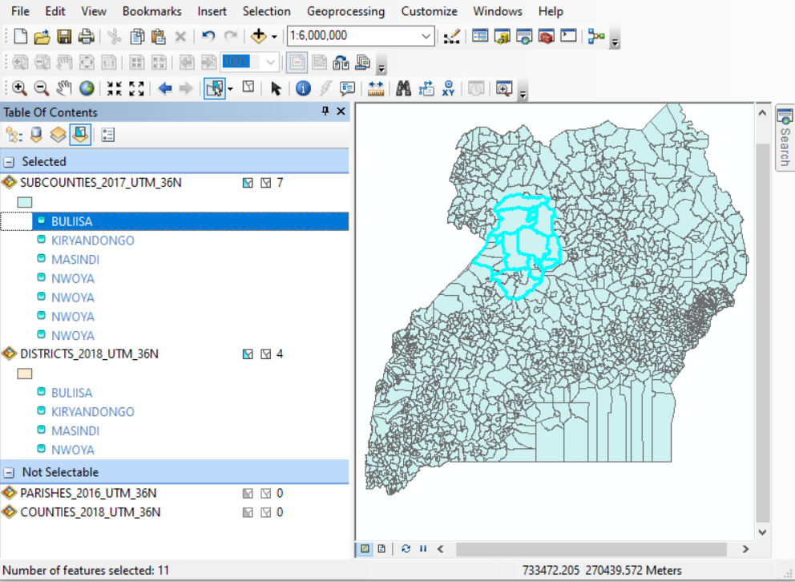
Selected Districts and Subcounties
Selectable Layers
Not selectable Layers

Slide 4
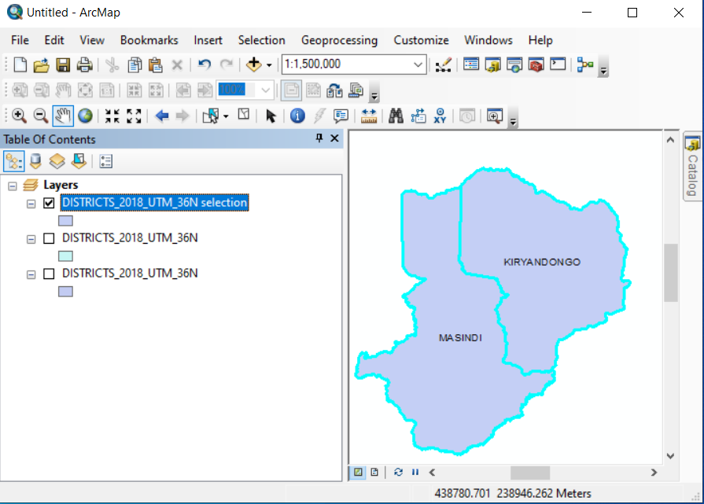
Creating New Layers from Selected Map Layer
In ArcMap, you can create new layer using the selected features in the mother layer. For example you can create layers for particular district from a particular mother layer that has all districts
Steps
Select the features of your choice as illustrated in the previous slides
Right Click the mother layer say district in the ToC
Click Create layer from selected features
A new layer is created. Use the ToC to put off some layers so that you can display the new created layer.
New Created District Layers for Masindi and Kiryandogo

Slide 5
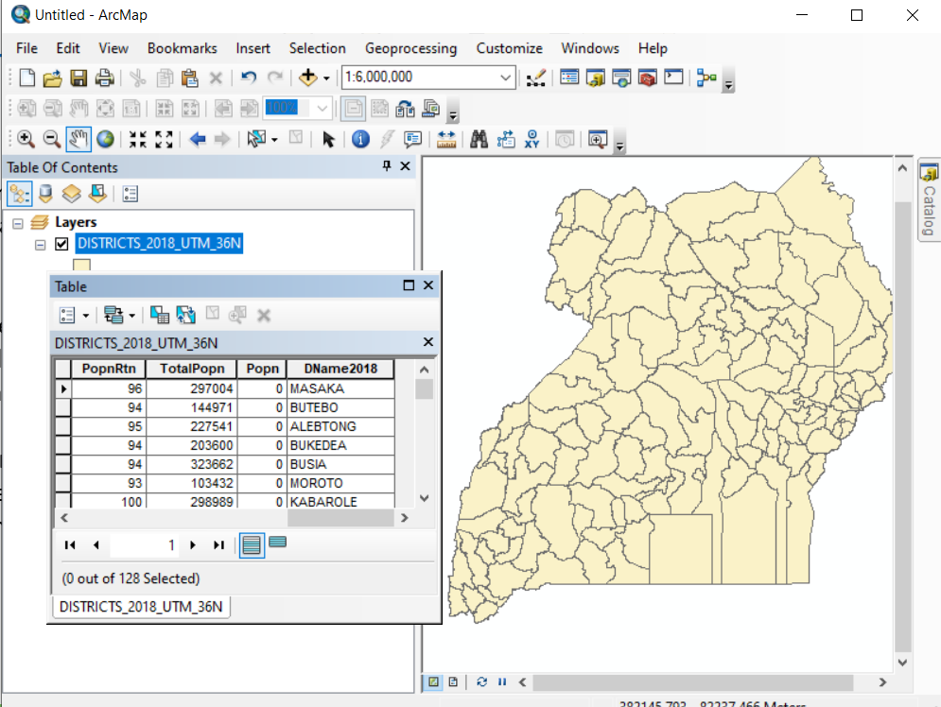
Working with Attributes Tables
Attribute Tables are commonly associated with spatial data that forms the map layer and the attribute values contained.
The Attribute tables can be used to find and query data in ArcMap. Attribute tables can be a tabular file containing information about a set of geographic features, usually arranged so that each row represents a feature and each column represents one feature attribute.
To Open Attribute table for existing Map layer, take the following steps:
Rick Click the Map layer in ToC you want to see the attribute table for example districts
Click on Open Attribute Table
Navigate to the any record of your choice in the table and Click its Row record.
Note that the selected record is also highlighted in the Map Layer. Right Click – Zoom, identify, Pan and use the tools tool bar to take measurements
Attribute Table

Slide 6
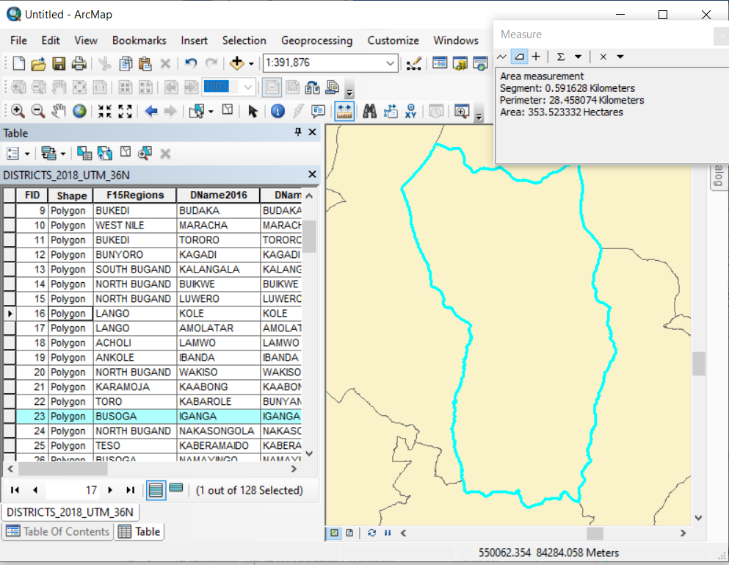
Illustration of some of the functions carried out in Attribute Table
Using Measure of the selected record from attribute table
Selecting feature in the attribute table
Zooming in the attributes table feature
Selected Record in the attributes table

Slide 7
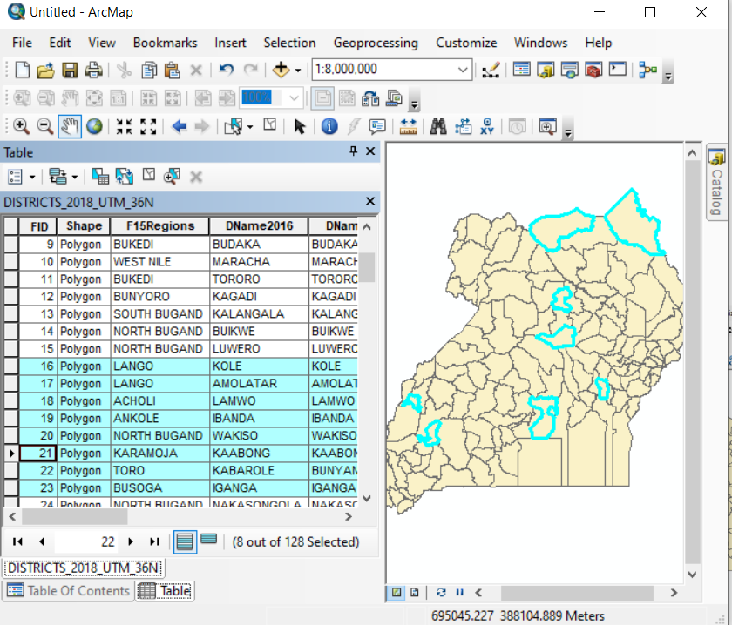
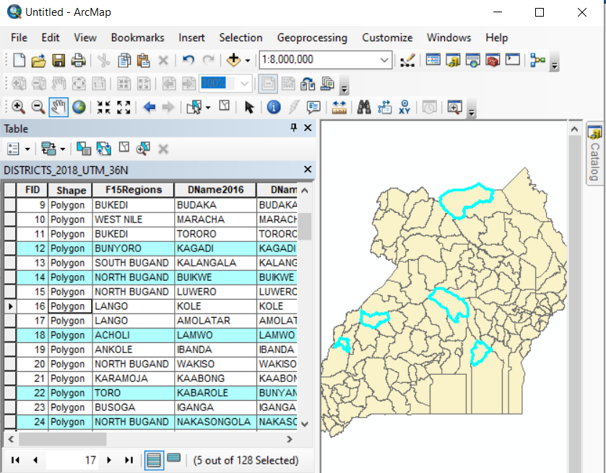
Selecting Multiple Records in the Attribute Table
ArcMap allows user to select more than one record in the attributes table in two ways:
Selecting sequential records in attributes table
Click to the first record to start selection
Hold the shift Key on your key board
Click the last record to be select. All records from the first to the last are selected.
Selecting unsequential records in attributes Table
Hold Ctrl key on your key board
Scroll and click on any record that you want to select in your attributes table
Records selected sequentially
Unsequential selection of records

Slide 8
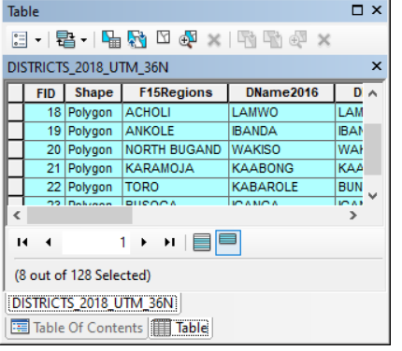

Switching between All records and selected Records
While in the attributes table, one may want to display only the selected records.
Use the selected record Icon to view only the selected records.
To view all records click on the All records Icon
All records are displayed
Displays only selected records

Slide 9
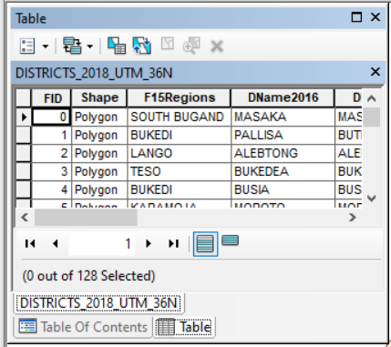
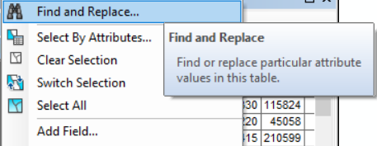
Switching Selections
With ArcMap, you can switch sections of the map layers that have been selected in the attributes table, select all records and unselected records.
The attributes table has an area for options found on the extreme left hand side.
Click the Table options button in the Attributes table
Try the following options: Find to search for any feature, Switch selection to navigate between selection, Select All to select all records and Clear selection to unclear all selected records
Table options button
Some of the Table Options

Slide 10
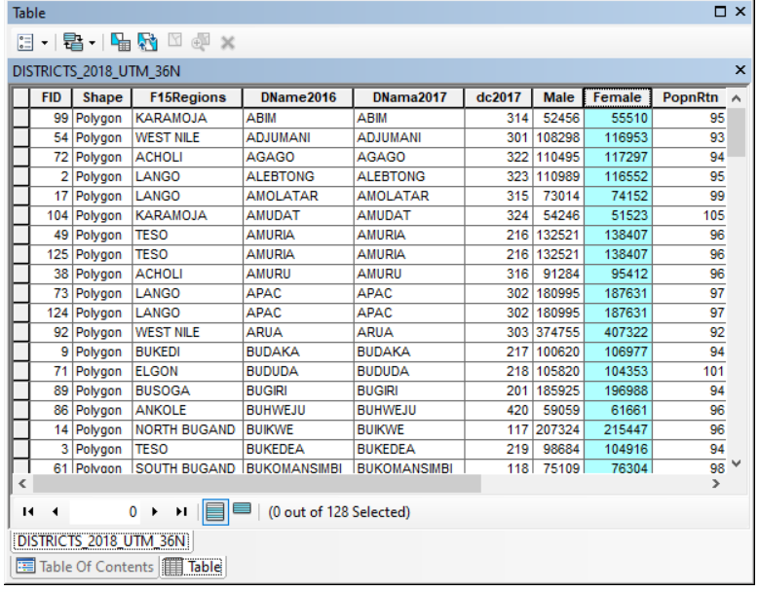
Moving or relocating fields in the Attributes Table
ArcMap permits users to rearrange fields in the attributes table using the drag and drop method. For example in the District Map layer you can move the column for Female to appear before Male. Note that all corresponding data are moved.
Steps:
Open the District Map Layer in the ToC
Right Click District in the TOC
Open Attributes Table
Click and Drag and Release the Female headings to the Left hand side. Note now it appears before Male
Click and Drag to the left hand side

Slide 11
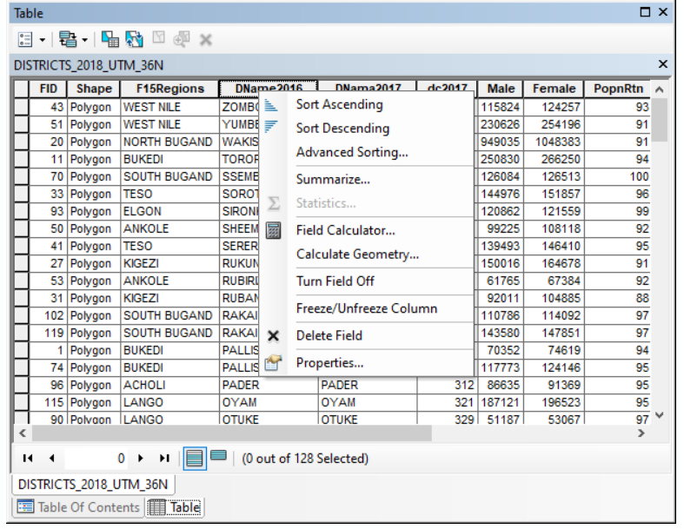
Sorting Fields in the Attributes Table
ArcMap allows sorting of fields in the attributes table either in ascending or descending order as per the users’ preference. Once fields are sorted, all associated data in the records correspond accordingly. For example districts can be sorted in ascending order in the district table.
Steps
Place the District map layer in the table of contents
Right Click District in the ToC
Select Open attributes Table
Right Click the column heading for the district
Select either Ascending or descending
Column heading for right clicking

Slide 12
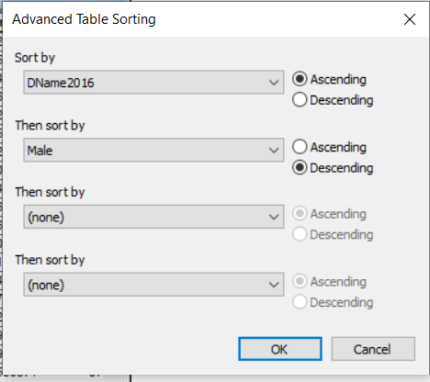
Advanced Sorting of Fields
At time one may need to reoragnise fields in series of order where some fields under particular column headings have several related fields. For example you want to sort districts in ascending order and in each district you sort sex in descending order. In this situation district becomes the field to sort followed by sex
Steps
Place the District map layer in the table of contents
Right Click District in the ToC
Select Open attributes Table
Right Click the column heading for the district
Select Advanced sorting
Select Sort by district - Ascending
Select Sort by sex - Descending
Sort by District
Sort by sex

Slide 13
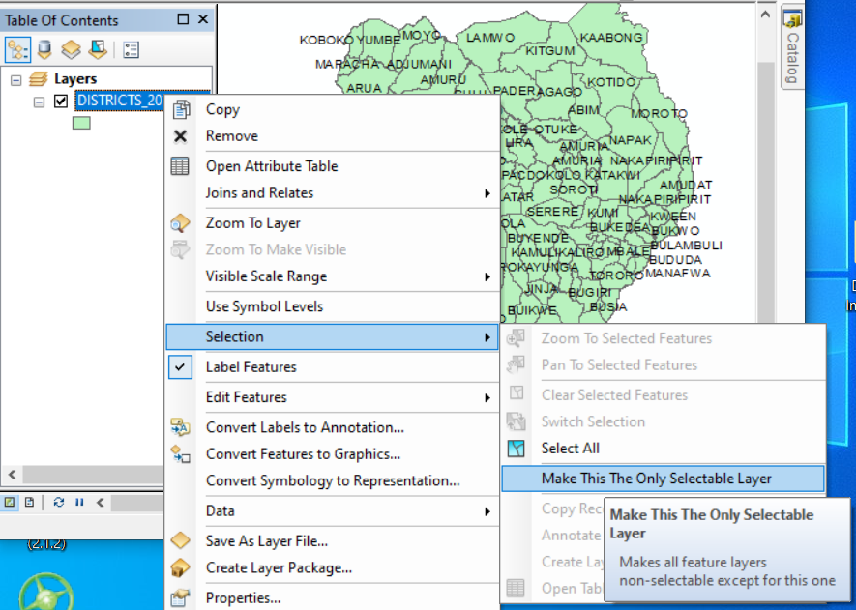
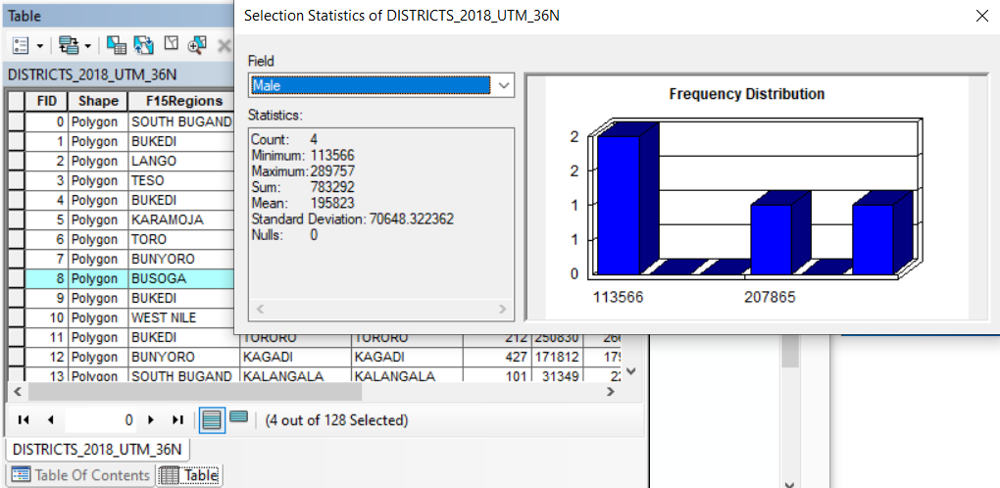
Getting Statistics in the attributes Table
We can obtain descriptive statistics such as mean, max, min, sum and standard deviation in columns that store numeric data in the attributes table. A histogram is also provided showing how the column's values are distributed. Statistics are calculated for all numeric columns in the table. We shall use the districts map layer to get some descriptive statistics on male, female and total population.
Steps
Place the Districts Map layer in full extent in the ToC
Right Click District in the ToC
Choose Make this as the only selectable layer
Hold Shift key and use select features tool to select the districts of Jinja, Masaka, Mable
In the ToC Right Click District
Choose Open attributes table
Right click the column heading for total population
Select Statistics
Statistics

Slide 14
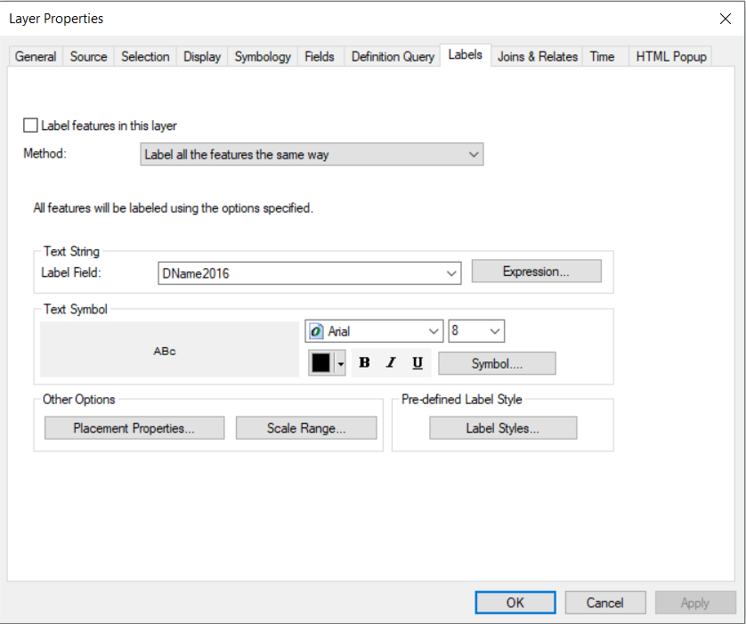
Label Features
Labels are text items on a map layer that are delivered from one or more feature attributes that are displayed in the ArcMap windows depending on the scale. For example in the map of layer of districts you may want to display male population for each district
Steps
Place the district shapefile in the ToC
Right Click Districts layer in the ToC
Select properties
Select the Label Tab
Select the label field you want to display e.g Male
Check the Label features in this Layer check box
Click Apply
Label Tab
Label field
Label Features in this Layer Check Box

Slide 15


